Slide 1







LET’S PLAY
Welcome to CodeQuest, a website designed to help players learn to code through fun and engaging games.
Our mission is to make coding education accessible and enjoyable for everyone, regardless of their experience level.
CODEQUEST

Slide 2


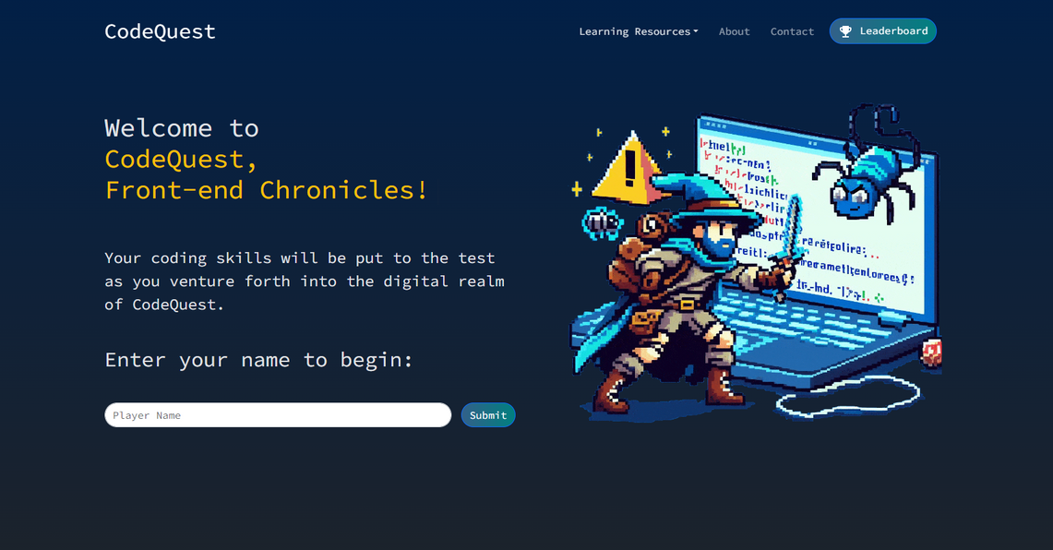
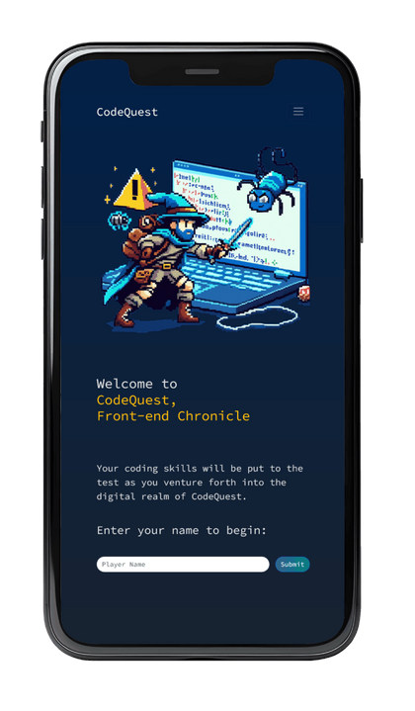
CONCEPT:
DESCRIPTION:
CODING GAME:
CodeQuest features a game with three levels that test the players’ knowledge of JavaScript, HTML and Bootstrap.
Each level is designed with a different art style and answer method. Top scores are presented in a leaderboard using Supabase as a database.

Slide 3
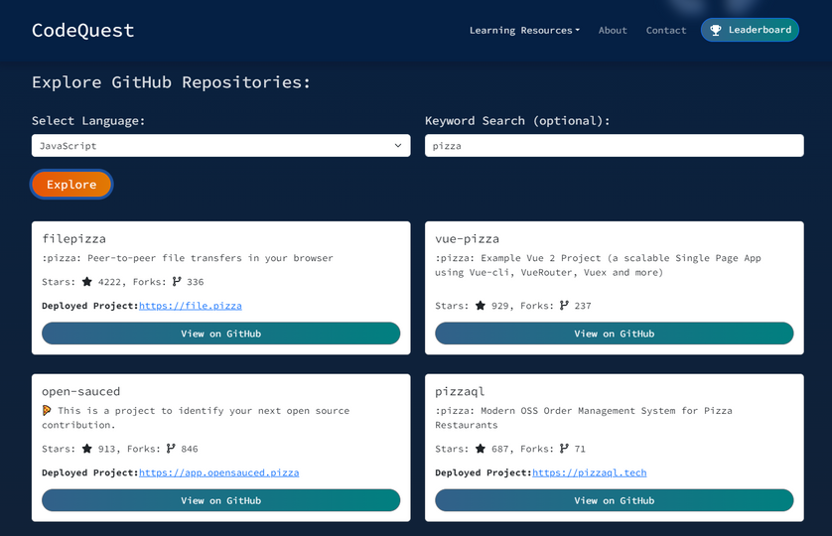
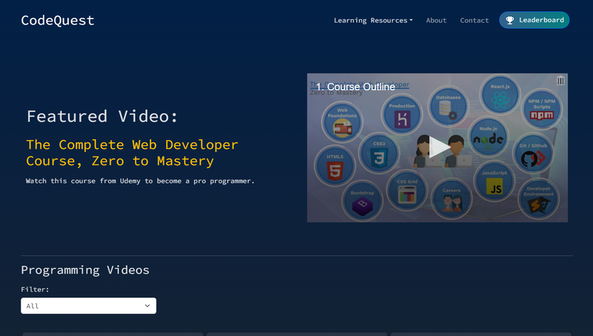
CONCEPT:
DESCRIPTION:
LEARNING RESOURCES:
GitHub Explorer:
Find interesting project repositories in your programming language of choice. It sorts the search results by the top 20 most starred repos.
Video Courses:
Find full courses and tutorials from the Internet Archive, with a filter to search by the particular language or area of development you are interested in learning about.

Slide 4

CONCEPT:
MOTIVATION FOR DEVELOPMENT:
We wanted to work on something fun for our final project. We also wanted to try building something in React without lots of examples online that we could use for reference.
USER STORY:
Whether you're a beginner just starting your coding journey or an experienced developer looking to refresh your knowledge, CodeQuest offers a fun way to test and build your skills.

Slide 5


PROCESS:
BREAKDOWN OF TASKS AND ROLES:
WE WORKED ON TASKS ON A CASE-BY-CASE BASIS EACH DAY, DEPENDING ON WHAT WAS NEEDED TO PROGRESS THE GAME DESIGN AND FUNCTIONALITY THAT DAY.
CHALLENGES:
COULDN’T DECIDE ON WHAT TYPE OF PROJECT TO DO INITIALLY!
Finding DIFFERENT LIBRARIES AND PACKAGES
Mapping out the components and wORKING ON A MORE COMPLEX CHALLENGE IN REACT
Successes:
WE HAVE WELL FUNCTIONING WEBSITE!
We CAN STORE DATA USING SUPABASE
VERY FEW MERGE CONFLICTS TO RESOLVE SINCE THE COMPONENT NATURE OF REACT MADE IT EASY TO REVIEW PULL REQUESTS

Slide 6



TECHNOLOGIES:
functionality:
REACT, REACT ROUTER
NODE JS,Vite JS
Git, GitHub
Netlify
Supabase
UUID, React Hot Toast
STYLE:
React Bootstrap
FontSource
Material-UI
Microsoft Designer
Popper Js
Slick Carousel
Typewriter-effect package
API:
INTERNET ARCHIVE API
GITHUB LANGUAGES API
Google Macros API

Slide 7
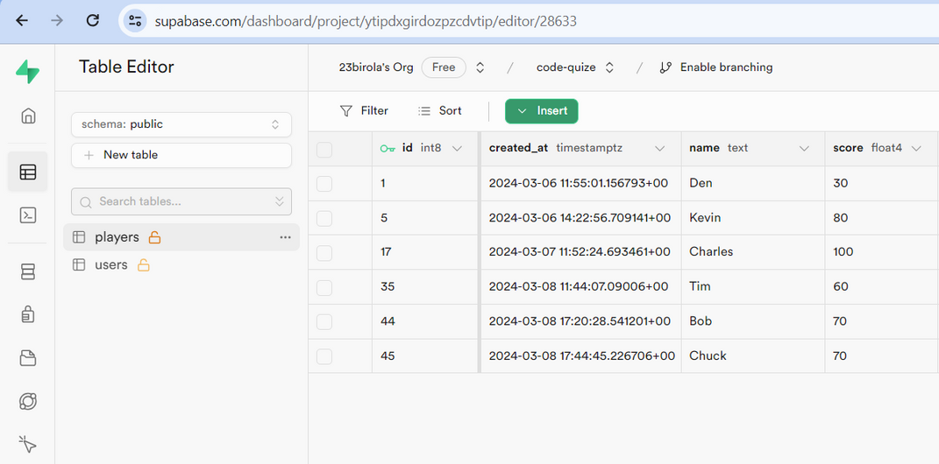

TECHNOLOGIES:
SUPABASE IS AN OPEN SOURCE FIREBASE ALTERNATIVE
makes it easy for developers
to create applications quickly
and efficiently
utilizes PostgreSQL
offers robust and intuitive documentation built right in
offers real-time data updates

Slide 8



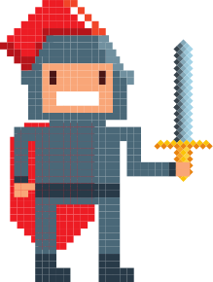



DEMO
LET’S GO!

Slide 9

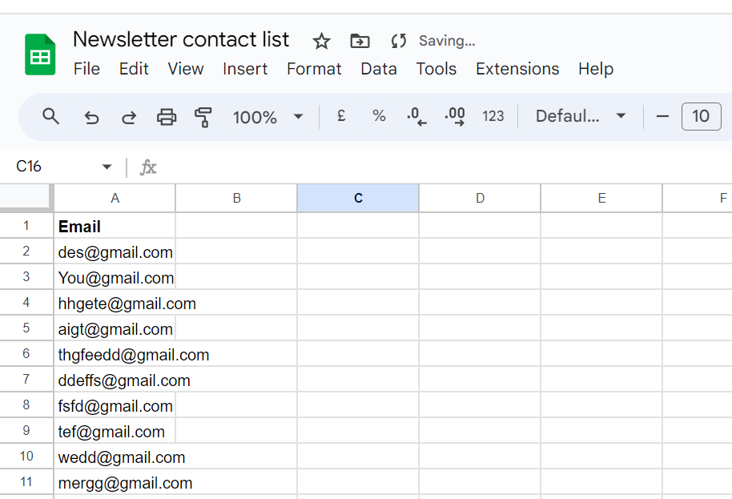
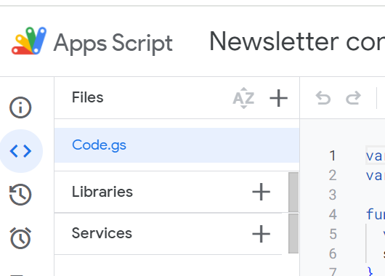

GOOGLE SHEETS DATA
The subscription input validates emails and, if the submitted email is valid, it is stored on a Google sheets, by using Google Apps Script.

Slide 10





DIRECTIONS FOR
FUTURE DEVELOPMENT
Add more code game levels
(games about React, Tailwind, etc.)
Add character avatars that the player can customize
Player can choose the theme of design

Slide 11








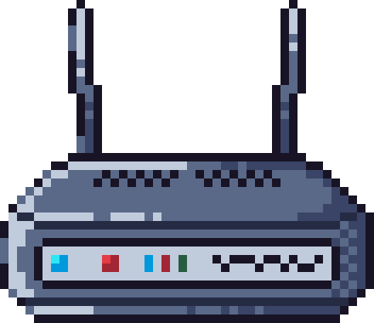
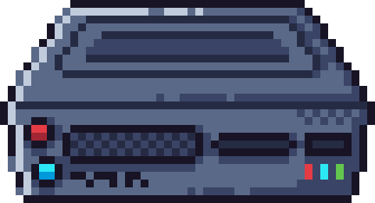


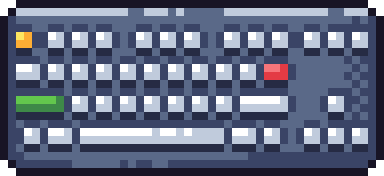

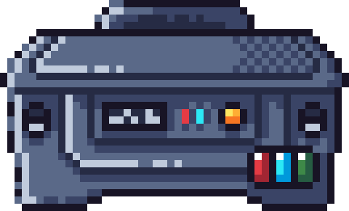




GAME OVER
GITHUB.COM/AOIFEEDX/CODE-QUEST
CODEQUEST-GAME.NETLIFY.APP

